Slide 1
Data Preparation
It includes two techniques that are listed below :
1. Data Preprocessing
2. Data Wrangling

Slide 2
Let’s take a look at the typical analytical pipeline when you build an analytic model:
1. Data Access
2. Data Preprocessing
3. Exploratory Data Analysis (EDA)
4. Model Building
5. Model Validation
6. Model Execution
7. Deployment
a. Step 2 focuses on data preprocessing before you build an analytic model
b. Data wrangling is used in step 3 and 4 to adjust data sets interactively while analyzing data and building a model.
c. Three steps (2,3 and 4) can include both data cleansing and feature engineering.

Slide 3
Data Preprocessing

Slide 4
1. Data Preprocessing :
is a technique that is used to convert the raw data into a clean data set. In other words, whenever the data is gathered from different sources it is collected in raw format which is not feasible for the analysis. Therefore, certain steps are executed to convert the data into a small clean data set. This technique is performed before the execution of Iterative Analysis.
Data Preprocessing Steps :
1. Data Cleaning
2. Data Integration
3. Data Transformation
4. Data Reduction
Need of Data Preparation and Preprocessing :
For achieving better results from the applied model in Machine Learning and Deep Learning projects the format of the data has to be in a proper manner. Some specified Machine Learning and Deep Learning model need information in a specified format, for example, Random Forest algorithm does not support null values, therefore to execute random forest algorithm null values has to be managed from the original raw data set.

Slide 5
How is Data Preprocessing performed?
First of all, let’s explain how missing data can be handled. Three different steps can be executed which are given below :
1. Ignoring the missing record : It is the simplest and efficient method for handling the missing data. But, this method should not be performed at the
time when the number of missing values are immense or when the pattern of data is related to the unrecognized primary root of the cause of
statement problem.
2. Filling the missing values manually : This is one of the best-chosen methods. But there is one limitation that when there are large data set, and missing
values are significant then, this approach is not efficient as it becomes a time-consuming task.
3. Filling using computed values : The missing values can also be occupied by computing mean, mode or median of the observed given values. Another
method could be the predictive values that are computed by using any Machine Learning or Deep Learning algorithm. But one drawback of this
approach is that it can generate bias within the data as the calculated values are not accurate concerning the observed values.

Slide 6
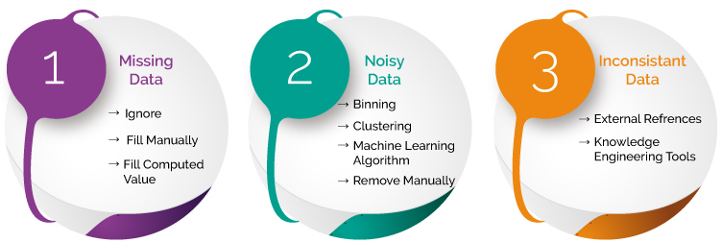
Let’s move further and discuss how we can deal with the noisy data. The methods that can be followed are given below :
1. Data Binning : In this approach sorting of data is performed concerning the values of the neighborhood. This method is also known as local smoothing.
2. Preprocessing in Clustering : In the approach, the outliers may be detected by grouping the similar data in the same group, i.e., in the same cluster.
3. Machine Learning : A Machine Learning algorithm can be executed for smoothing of data. For example, Regression Algorithm can be used for smoothing of
data using a specified linear function.
4. Removing manually : The noisy data can be deleted manually by the human being, but it is a time-consuming process, so mostly this method is not given
priority. To deal with the inconsistent data manually, the data is managed using external references and knowledge engineering tools like the knowledge
engineering process.

Slide 7
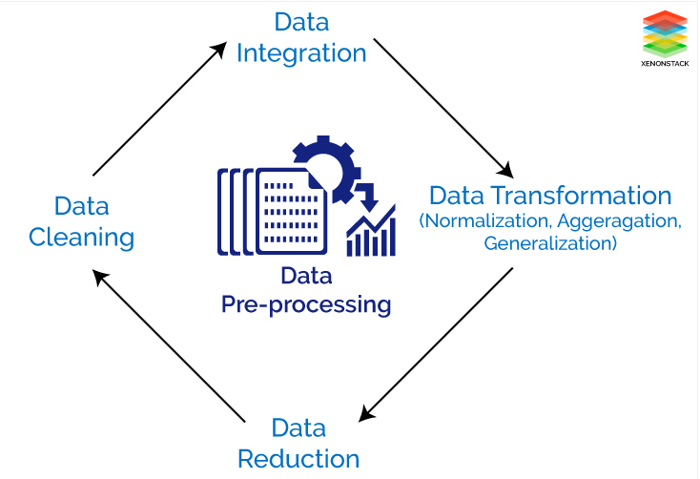
Tasks of Data Preparation
Different steps are involved for Data Preprocessing. These steps are described below –
1. Data Cleaning : This is the first step which is implemented in Data Preprocessing. In this step, the primary focus is on handling missing data, noisy data,
detection, and removal of outliers, minimizing duplication and computed biases within the data.
2. Data Integration : This process is used when data is gathered from various data sources and data are combined to form consistent data. This consistent data
after performing data cleaning is used for analysis.
3. Data Transformation : This step is used to convert the raw data into a specified format according to the need of the model. The options used for
transformation of data are given below –
a. Normalization – In this method, numerical data is converted into the specified range, i.e., between 0 and one so that scaling of data can be performed.
b. Aggregation – The concept can be derived from the word itself, this method is used to combine the features into one. For example, combining two
categories can be used to form a new group.
c. Generalization – In this case, lower level attributes are converted to a higher standard.
4. Data Reduction : After the transformation and scaling of data duplication, i.e., redundancy within the data is removed and efficiently organize the data.

Slide 8
Data Wrangling

Slide 9
2. Data Wrangling :
is a technique that is executed at the time of making an interactive model. In other words, it is used to convert the raw data into the format that is convenient for the consumption of data. This technique is also known as Data Munging. This method also follows certain steps such as after extracting the data from different data sources, sorting of data using certain algorithm is performed, decompose the data into a different structured format and finally store the data into another database.
Need of Data Wrangling :
Data Wrangling is an important aspect of implementing the model. Therefore, data is converted to the proper feasible format before applying any
model to it. By performing filtering, grouping and selecting appropriate data accuracy and performance of the model could be increased. Another
concept is that when time-series data has to be handled every algorithm is executed with different aspects. Therefore Data Wrangling is used to
convert the time series data into the required format of the applied model. In simple words, the complex data is transformed into a usable format
for performing analysis on it.

Slide 10
Why is Data Wrangling Important?
Data Wrangling is used to handle the issue of Data Leakage while implementing Machine Learning and Deep Learning. First of all, we have to understand what Data Leakage is?
Data Leakage in Machine Learning and Deep Learning
Data Leakage is responsible for the cause of invalid Machine Learning/Deep Learning model due to the over optimization of the applied model.
Data Leakage is the term used when the data from outside, i.e., not part of training dataset is used for the learning process of the model. This additional learning of information by the applied model will disapprove the computed estimated performance of the model.
For example when we want to use the particular feature for performing Predictive Analysis, but that specific feature is not present at the time of training of dataset then data leakage will be introduced within the model.
Data Leakage can be demonstrated in many ways that are given below :
a. The Leakage of data from test dataset to training data set.
b. Leakage of computed correct prediction to the training dataset.
c. Leakage of future data into the past data.
d. Usage of data outside the scope of the applied algorithm
In general, the leakage of data is observed from two primary sources of Machine Learning/Deep Learning algorithms such as feature attributes (variables) and training data set.

Slide 11
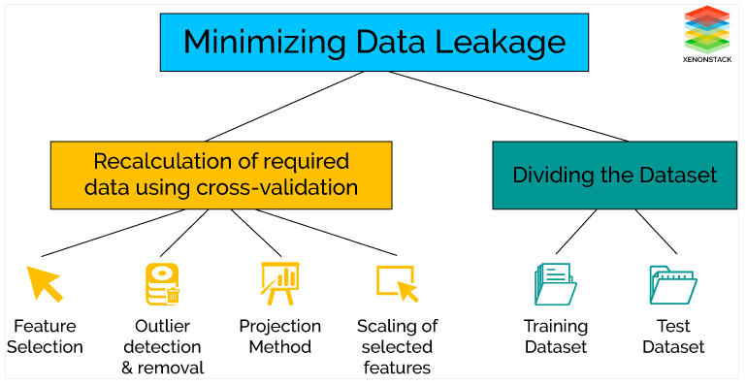
How is Data Wrangling performed?
Data Wrangling is conducted to minimize the effect of Data Leakage while executing the model. In other words if one considers the complete data set for normalization and standardization, then the cross-validation is performed for the estimation of the performance of the model leads to the beginning of data leakage.
Another problem is also observed that the test model is also included for feature selection while executing each fold of cross-validation which further generates bias during performance analysis.
The effect of Data Leakage could be minimized by recalculating for the required Data Preparation during the cross-validation process that includes feature selection, outliers detection, and removal, projection methods, scaling of selected features and much more.
Another solution is that dividing the complete dataset into training data set that is used to train the model and validation dataset which is used to evaluate the performance and accuracy of the applied model.
But, the selection of the model is made by looking at the results of test data set in the cross-validation process. This conclusion will not always be valid as the sample of test data set could vary, and the performance of different models are evaluated for the particular type of test dataset. Therefore, while selecting best model test error is overfitting.
To solve this problem, the variance of the test error is determined by using different samples of test dataset. In this way, the best suitable model is chosen.

Slide 12
Data Preparation vs Data Wrangling
Data Preprocessing is performed before Data Wrangling. In this case, Data Preprocessing data is prepared exactly after receiving the data from the data source. In this initial transformations, Data Cleaning or any aggregation of data is performed. It is executed once.
For example, we have data where one attribute has three variables, and we have to convert them into three attributes and delete the special characters from them. It is the concept that is performed before applying any iterative model and will be executed once in the project.
On the other hand, Data Wrangling is performed during the iterative analysis and model building. This concept at the time of feature engineering. The conceptual view of the dataset changes as different models is applied to achieve good analytic model.
For example, we have data containing 30 attributes where two attributes are used to compute another attribute, and that computed feature is used for further analysis. In this way, the data could be changed according to the requirement of the applied model.

Slide 13
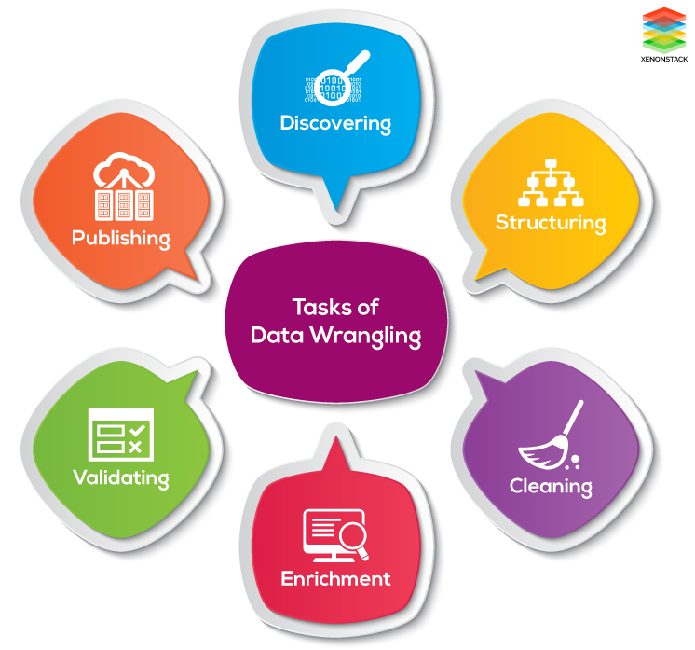
Tasks of Data Wrangling
The tasks of Data wrangling are described below –
1. Discovering : Firstly, data should be understood thoroughly and examine which approach will best suit. For example: if have a weather data when we analyze
the data it is observed that data is from one area and so primary focus is on determining patterns.
2. Structuring : As the data is gathered from different sources, the data will be present in various shapes and sizes. Therefore, there is a need for structuring the
data in proper format.
3. Cleaning : Cleaning or removing of data should be performed that can degrade the performance of analysis.
4. Enrichment : Extract new features or data from the given data set to optimize the performance of the applied model.
5. Validating : This approach is used for improving the quality of data and consistency rules so that transformations that are applied to the data could be verified.
6. Publishing : After completing the steps of Data Wrangling, the steps can be documented so that similar steps can be performed for the same kind of data to
save time.

